Slide 1
INTERACTIVE SNAKE AND LADDER
CMPE 244 Embedded Software
Team: Abhishek Singh (011413311)
Aniket Bapat (011431069)
Bhupendra Naphade (010703836)
Jerry John (010953501)
Saurabh Deshmukh (011435060) Instructor: Preetpal Kang

Slide 2
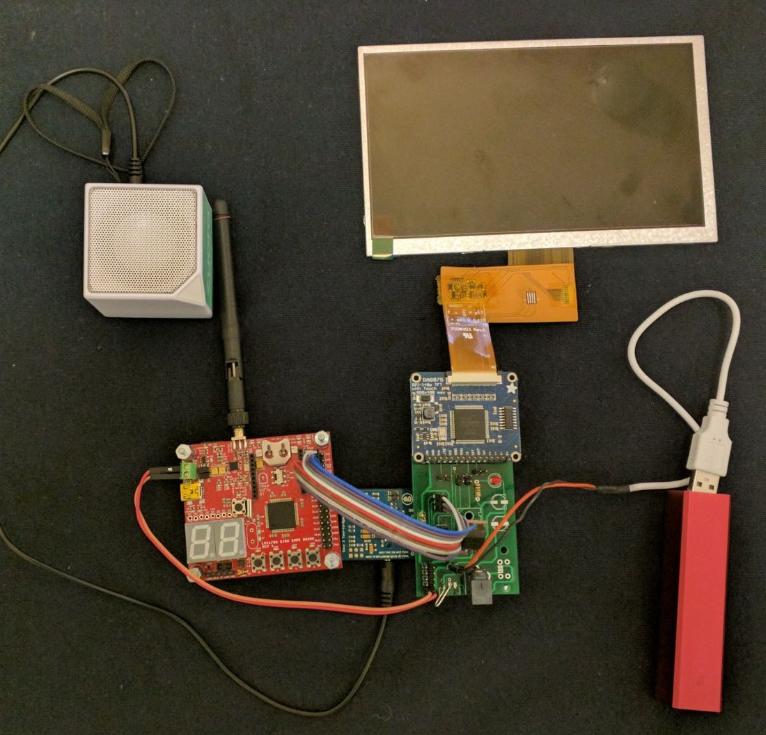
Overall System.
Game board (TFT LCD) console and display: The snake and ladder board grid is displayed on the 7 inches LCD screen.
Wireless SJone remote: The antenna connected SJone board functioning as the remote.
Audio prompts: Based on the actions performed the audio file gets executed. To make a game more effective and attractive.

Slide 3
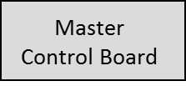
System Block Diagram
Remote Control 1
Power Supply
LCD Screen
SPI
UART
SPI
Remote Control N
SD Card
Power Supply

Slide 5
Thank You

