Slide 1
CMPE240 Project: The Barkmaster2000 (Keeping dogs entertained since yesterday)
Prepared By:
Bryan Canepa
Patrick Ghorbanian
Sake Dog

Slide 2
Concept of Design
The Barkmaster2000 encourages your dog to bark
Barkmaster2000 waits in idle state for a bark
If the bark is angry enough it will start spinning
The barkmaster2000 incorporates an IR sensor to detect barking dog
When the IR sensor is triggered the barkmaster will drive forward
Goal is to drive towards the dog to keep her barking

Slide 3
State Diagram
RESET
1
Motor Driver Board Init()
(Bark < Threshold)
1
CLEAR
DATA & STOP
IDLE
1
1
(Bark >= Threshold)
FORWARD
DRIVE
_DETECT
_IRsensorCleared
Irsensor
Detect
SPIN
DETECT
IRsensorCleared

Slide 4
Bark Detection
Polls four MEMs audio sensors for input
MEMs inputs provide analog representation of sound
Analog mux used to select MEMs device while in idle state
GPIO used for addressing mux
Inputs provided to ADC for determination of an “angry bark”
“Angry bark” determined by integrating digitized sound
Even sampling at 2ms – looking for low frequency to avoid noise
Adds samples over time and compares to a threshold

Slide 5
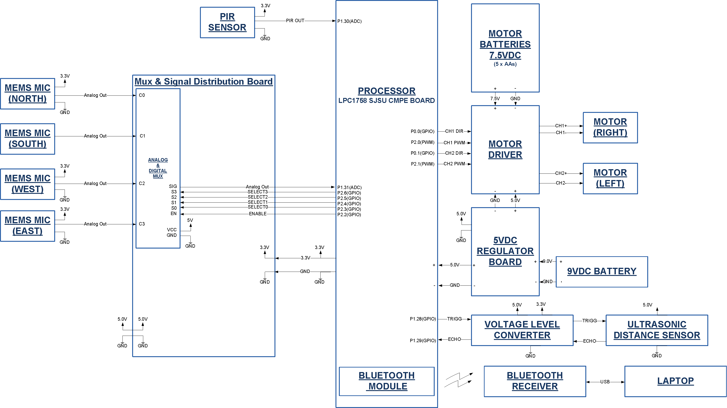
SCHEMATIC

Slide 6
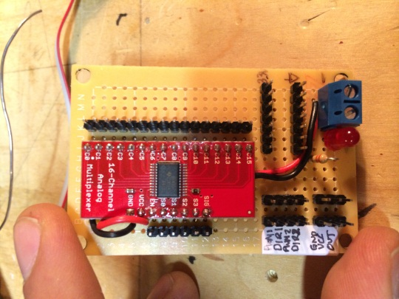
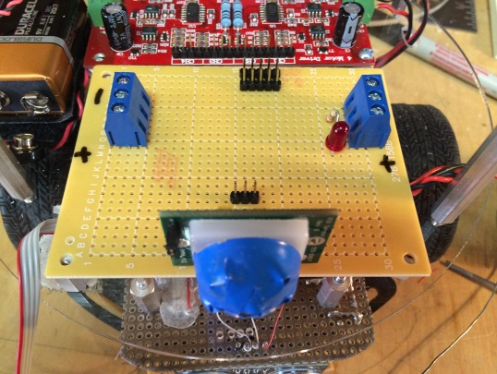
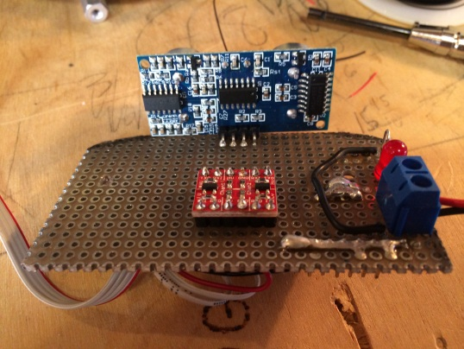
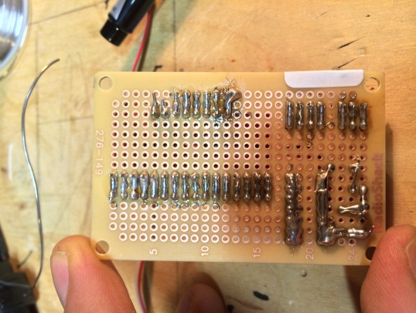
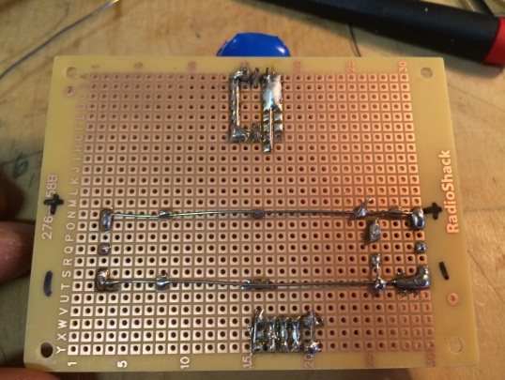
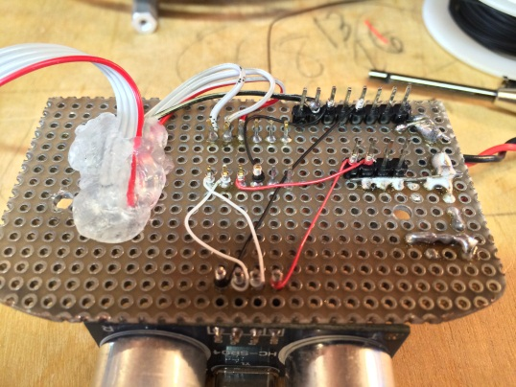
CUSTOM CIRCUIT BOARDS
MUX & SIGNAL
DISTRIBUTION
BOARD
PIR
SENSOR
BOARD
ULTRASONIC
SENSOR
BOARD

Slide 7
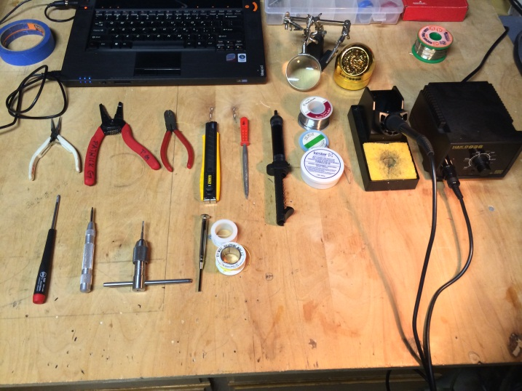
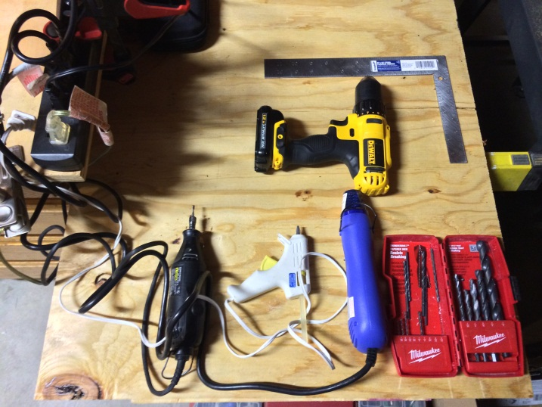
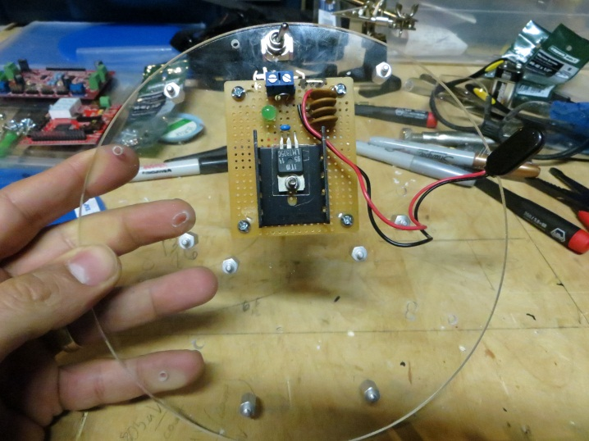
TOOLS AND 5V REGULATOR BOARD
ASSEMBLY TOOLS
ASSEMBLY TOOLS
5V REGULATOR
BOARD

Slide 8
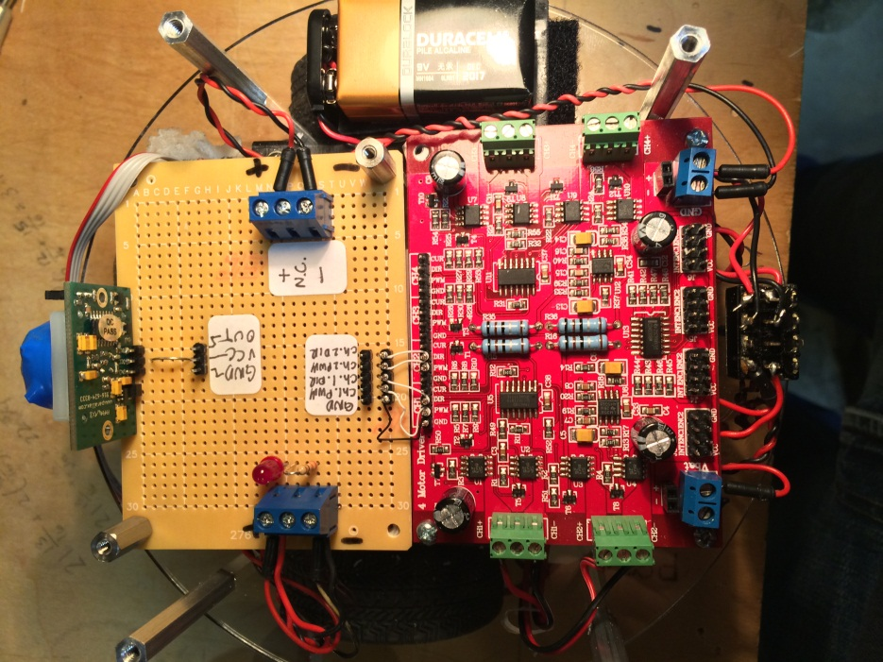
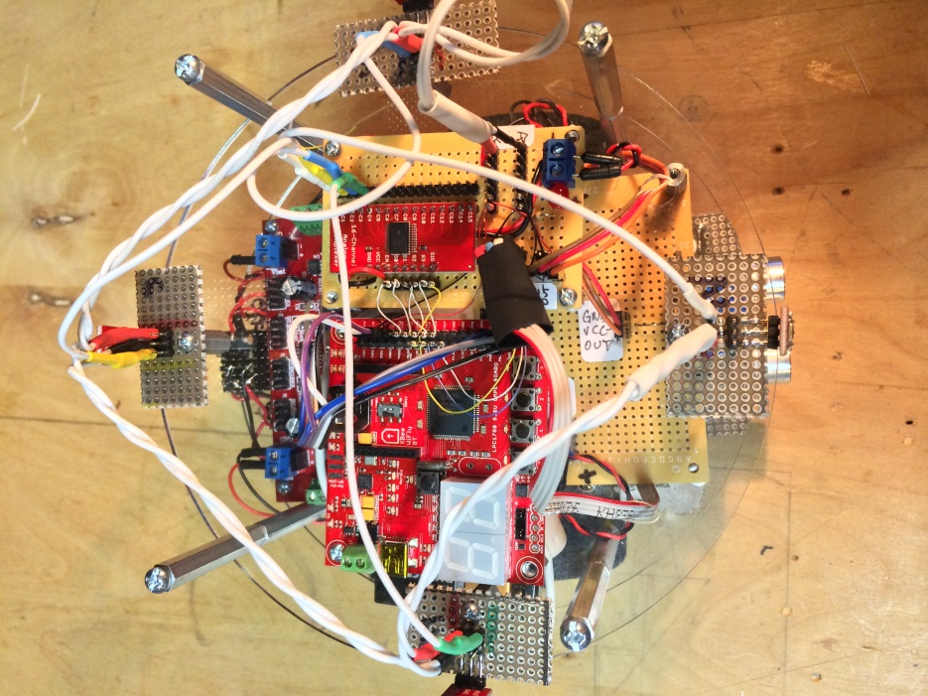
TOP VIEW OF THE DIFFERENT LEVELS
TOP VIEW
LEVEL 1
TOP VIEW
LEVEL2

Slide 9
Challenges
Noise from MEMS sensor was causing issues with bark sensing
Measured output on scope – lots of high frequency
Did experiment with different wire lengths showing noise increase
Used pull-downs within LPC1758 to reduce coupled noise
Sampled MEMs devices at low frequency (via software) to reduce noise
Acquiring data on a moving object
Suspected onboard electronics corrupting sound data
Needed to see sound outputs to debug while Barkmaster2000
Added Bluetooth capability to get live sampling while operating
Distance sensing
Original intention was to sense distance and stop if it got too close
Further testing showed that sensing would limit the movement too much
More fun to have the Barkmaster2000 just drive right at the dog without stopping
Narrowing the range of the IR sensor
IR sensor would pick out a 180 degree field
Taped the exterior of the sensor - small window for sensing
Not 100% accurate but sufficient to entertain the dog

Slide 10
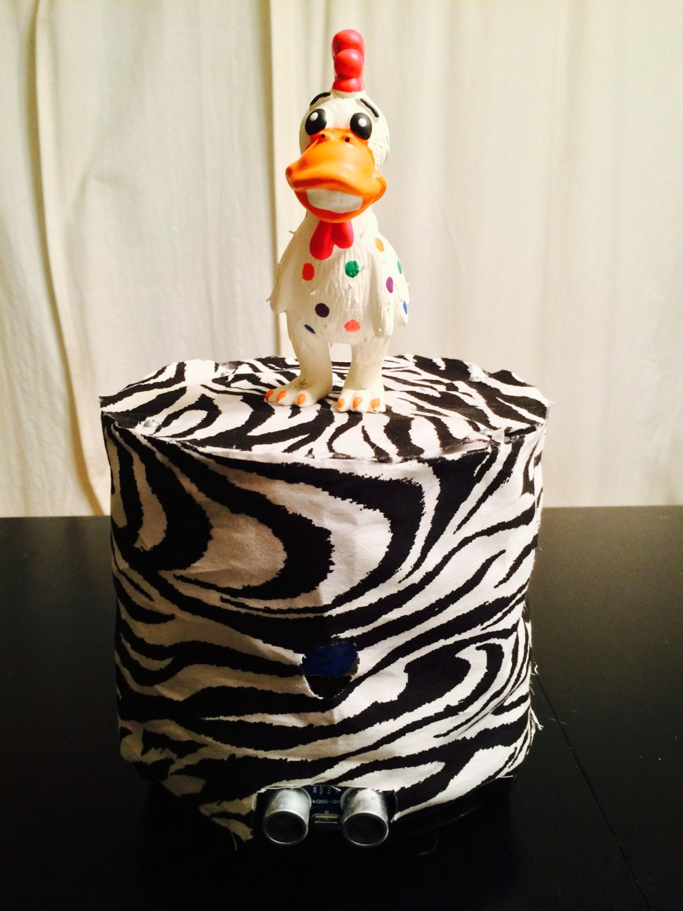
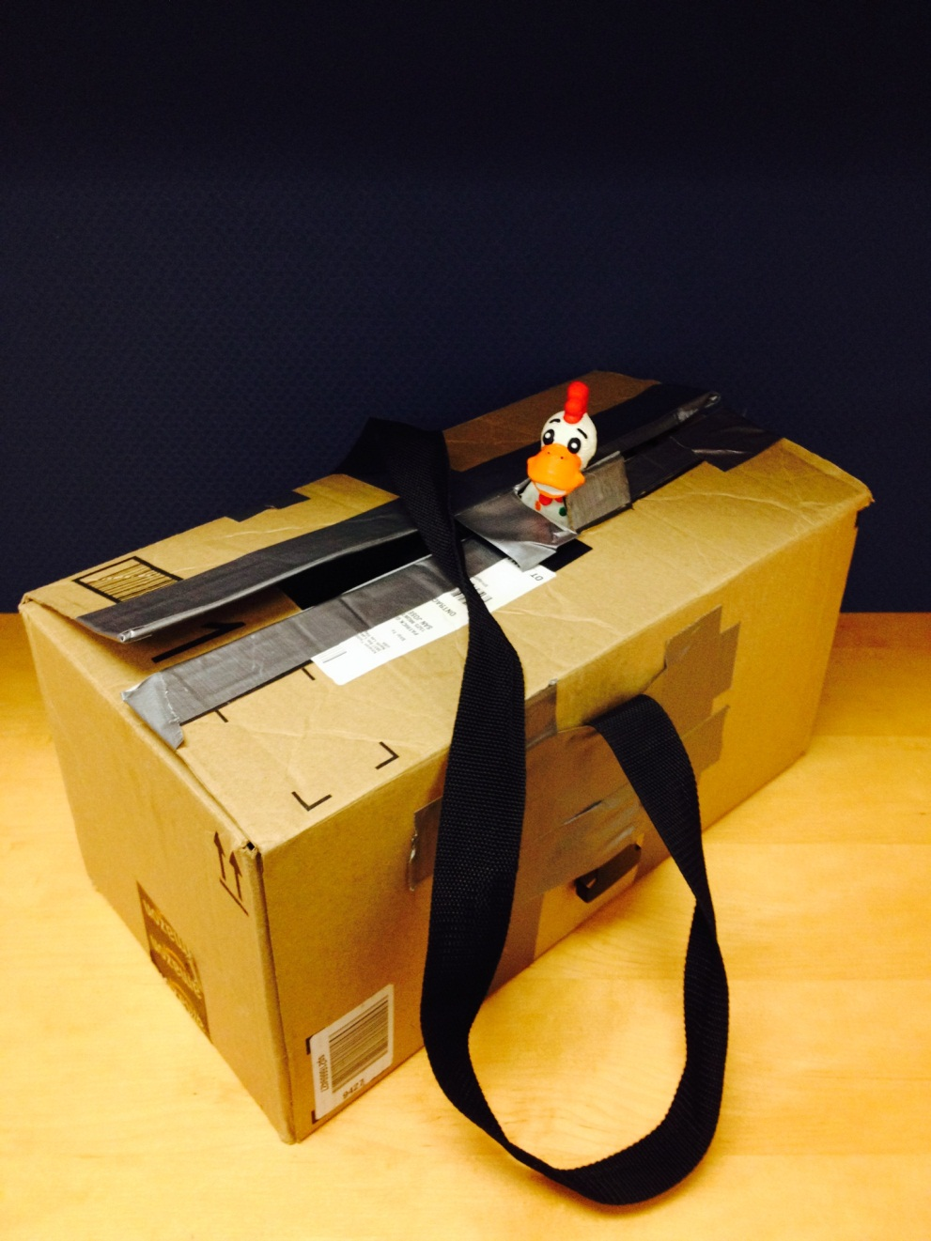
The Final Product
Handsome Carrying Tote !!

Slide 11
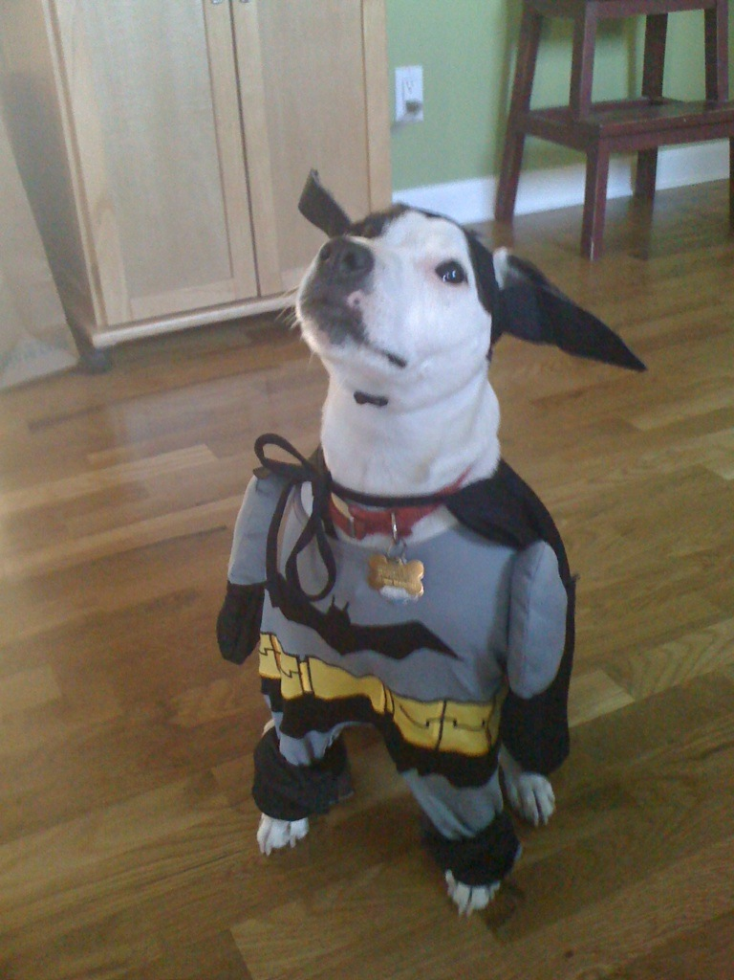
Test Subject

Slide 12
Unleash the Hounds

Slide 13
Professor’s Name is Virus

Slide 14
Summary
Barkmaster2000 successfully entertains Bryan’s dog
Hardware incorporates:
San Jose State processor board
Analog Mux
4 MEMs audio sensors
IR sensor
On board 5V battery (from 9V source)
On board motor power
Ultrasonic distance sensor (disabled for normal operation)
A squeaky rubber chicken
Utilizes LPC1758:
PWM motor drive
ADC inputs for sound sensing
GPIO for selection of mux channels and IR sensor
Bluetooth and LED screen for debugging

Slide 15
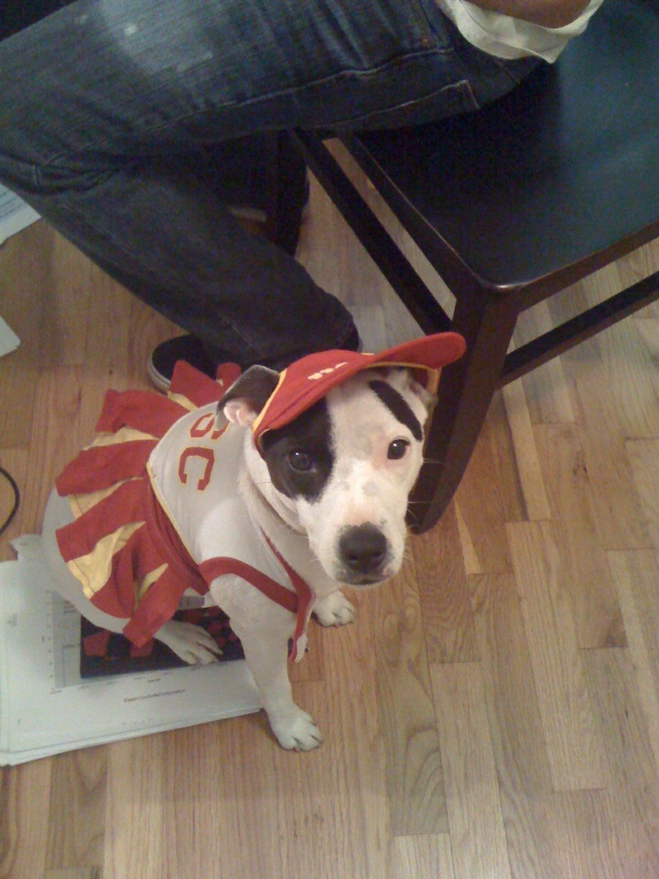
The End

