Slide 1
Spread Spectrum Audio Visualizer
By
Jaswanth Bhimanapalli
Sucharitha Sirigireddy
Tianran Chen
Wie Liu

Slide 2
Agenda
Introduction and Block diagram
Implementation of ADC
FFT integration
LED Matrix initialization (I2C)
Integration testing and bug fixing
Further improvements
Conclusion & Demo

Slide 3
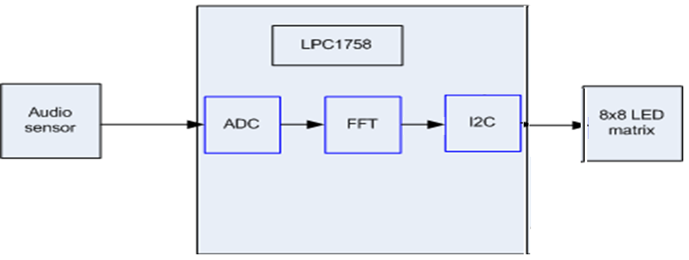
Block diagram

Slide 4
Introduction and Block diagram
Fundamental frequency of
male voice 85 to 180 Hz
female from 165 to 255 Hz
Audible frequencies 20 Hz to 20 KHz

Slide 5
Implementation of ADC
Timer 3,Channel 3,12bit
Sampling frequency 8KHz-44.1KHz
Queue to send converted data from ADC
A semaphore to give a sample from ADC to FFT
Test ADC result

Slide 6
FFT Integration
Cooley-Tukey algorithm for FFT
Takes O(N log N)time to compute FFT on given samples
Project uses 128-point FFT
Modified according to project requirements
Frequency resolution Δf=fs/N
fs=Sampling frequency
N=128
Δf=62.5 Hz
Time interval between samples=1/Δf =0.016 sec
Verified ADC result

Slide 7
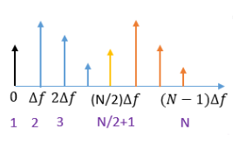
FFT Integration
X[1] represents DC frequency component
X[2] to X[N/2] terms are positive frequency components
X[N/2+1] is the Nyquist frequency (Fs/2Fs/2)
X[N/2+1] to X[N] terms are considered as negative frequency components

Slide 8
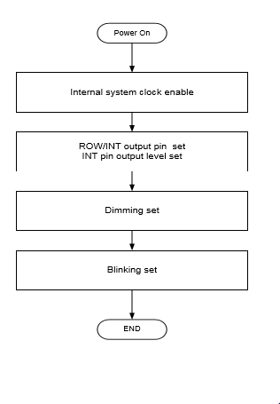
LED Matrix initialization
Standard mode of I2C (100KHz)
Sequence to initialize LED matrix
i2cLED.writeReg(0xE0,0x21,0x00);
i2cLED.writeReg(0xE0,0xA0,0x00);
i2cLED.writeReg(0xE0,0x81,0x00);
Write Data to RAM

Slide 9
LED Matrix initialization
X – axis for sampling frequency
Y-axis for power spectrum
To fit the samples onto 8 * 8 LED, create bins
X-axis max frequency is 4Khz and displayed in increments of 500 Hz
Y-axis max value is 4096(2*12) and is showing in steps of 512

Slide 10
Integration testing and bug fixing
Tested each module individually
Integrated ADC with FFT
FFT and LED Matrix
All three modules integrated

Slide 11
Further improvements
Use bandpass filter at the input
LCD can be used for displaying spectrum

Slide 12
Conclusion & Demo

